Slide 1








Java Basics
Proudly recognized by

Slide 2
Introduction to Java
Java Compilation Process and JIT Compiler
Classes and Objects
OOP concepts
Control Flow & Loops in Java
Java Methods
Java Constructors
Access Modifiers
Static Keyword
Exceptions
POJO
Singleton
Immutability
Agenda

Slide 3
Introduction to Java
What is Java?
High-level, object oriented, and platform-independent programming language.
Based on the principle = “Write Once, Run Anywhere”
Used for web, mobile, desktop, cloud and enterprise applications.
Key Features
Platform independent: Runs on any system with JVM
Object-Oriented: Focuses on real-world modelling using classes and objects.
Robust and Secure: Strong memory management and exception handling
Rich API and Ecosystem : Huge library support and community.

Slide 4
Java Compilation Process and JIT Compiler
JVM Interpreter/ JIT Compiler
Source Code (.java)
Byte Code (.class)
Machine Code
Bytecode is platform-independent, so the same file can run on Windows, macOS, or Linux.
JIT Compilation
Just In Time (JIT) compiler is a part of the JVM that improves performance at runtime.
Frequently executed bytecode is translated into machine code.
The compiled native code is cached, so subsequent execution are faster.
JIT identifies “hot” methods (executed frequently),

Slide 5
Class and Objects
Think of a class as a blueprint, and an object as the actual thing built from it.
Defines attributes (state) and methods (behavior) that its objects will have.
We can create multiple objects from the same class, each with its own data
class Car {
String color;
void start() {
System.out.println("Car started");
}
}
Car myCar = new Car();
myCar.color = "Red";
myCar.start();
Car yourCar = new Car();
yourCar.color = "Blue";
yourCar.start();

Slide 6
OOP Concepts
Procedural Programming (Before OOP) ← Code revolves around functions acting on data
OOP ← Code revolves around object that combine data and behaviour
// Object-Oriented Style
class Account {
private int balance = 0;
void deposit(int amount) { balance += amount; }
void withdraw(int amount) { balance -= amount; }
}
// Procedural Style
int balance = 0;
void deposit(int amount) {
balance += amount;
}
void withdraw(int amount) {
balance -= amount;
}

Slide 7
OOP Concepts
Encapsulation and Abstraction
Encapsulation : data and logic live together inside as one unit +Controlled Access
Abstraction: Hiding Complexity. Focus only on essential behavior, not the internal details.
class Account {
private double balance; // Encapsulation
public void deposit(double amount) {
if (amount > 0) {
balance += amount;
}
}
public double getBalance() {
return balance;
}
// Abstract method — no body, must be implemented by child
abstract void calculateInterest();
}
Inheritance
Reusability: A child class gets properties and behaviors from a parent.
class SavingsAccount extends Account {
@Override
void calculateInterest() {
double interest = getBalance() * 0.04;
System.out.println("Savings Account Interest: " + interest);
}
}
class CurrentAccount extends Account {
@Override
void calculateInterest() {
double interest = getBalance() * 0.02;
System.out.println("Current Account Interest: " + interest);
}
}
Polymorphism : Same interface, different behavior at runtime or compile time. Method overloading vs Overriding
Account acc1 = new SavingsAccount(); // Upcasting
Account acc2 = new CurrentAccount(); // Upcasting
acc1.deposit(1000);
acc2.deposit(2000);
acc1.calculateInterest(); // Calls SavingsAccount version
acc2.calculateInterest(); // Calls CurrentAccount version
.

Slide 8
Control Flow and Loops in Java
Decision Making
Control flow determines the order in which statements.
Java provides statements to make decisions and repeat actions.ecute in a program.
Statement | Description | Example
if | Executes block if condition true | if (age > 18)
if-else | Executes one block or another | if (x > 0) ... else ...
else if | Checks multiple conditions | if (a > b) ... else if ...
switch | Executes code based on value | switch(day) { case 1: ... }
Looping
Loop Type | Use Case | Example
for | Repeat a fixed number of times | for (int i=0; i<5; i++)
while | Repeat until condition false | while (i < 5)
do-while | Executes at least once | do { ... } while (i < 5);
for-each | Loop over arrays or collections | for (int x : arr)
Control Transfer
Keyword | Purpose
break | Exit loop or switch
continue | Skip current iteration
return | Exit from a method

Slide 9
Java Methods
A method is a block of code that performs a specific task.
Defines behaviour of an object or class.
Promotes code reusability
Improve readability and organization
Enable modular design
returnType methodName(parameters) {
// method body
return value; // optional
}
Why Methods?
Syntax
class Calculator {
// Method without return
void greet() {
System.out.println("Welcome to Calculator!"); }
// Method with parameters and return value
int add(int a, int b) { return a + b;
}
//static method
static void info(){
System.out.println("Instantiate Calculator, and use sum");
}
}
public class Main {
public static void main(String[] args) {
Calculator.info();
Calculator calc = new Calculator();
calc.greet(); // Method call
int sum = calc.add(5, 10); // Method call with arguments
System.out.println("Sum: " + sum);
}

Slide 10
Java Constructor
A constructor is a special method used to initialize objects when they are created.
It has the same name as the class and no return type.
Unlike methods, you don’t have to call it — Java calls it for you.
returnType methodName(parameters) {
// method body
return value; // optional
}
class Student {
String name;
int age;
// default constructor
Student(){
name = “unknown”;
age = 21;
}
// Parameterized Constructor
Student(String n, int a) {
name = n;
age = a;
System.out.println("Student created: " + name + ", " + age);
}
}
Syntax
public class Main {
public static void main(String[] args) {
Student s1 = new Student("John", 26); // Constructor call
Student s2 = new Student("Albert", 21);
}
}

Slide 11
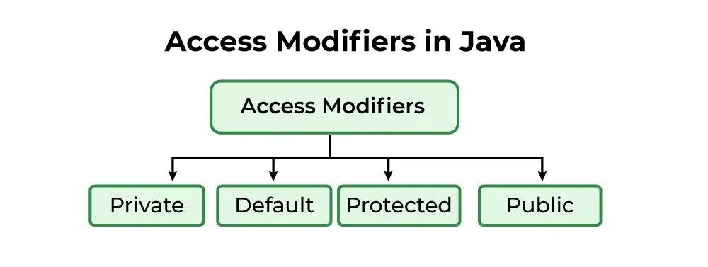
Access Modifiers
Helps to restrict the scope of a class, constructor, variable, method, or data member.
Provides security, accessibility, etc. to the user depending upon the access modifier used with the element.
Private - Accessible only within the class in which they are declared.
Default - Accessible only within the same package.
Protected - Accessible within the same package or subclasses in different packages.
Public - Accessible from everywhere in the program. There is no restriction on the scope of public data members.

Slide 12
Static Keyword
The static keyword means the member belongs to the class itself, not to any specific object.
You can have static variable, method, block and class
Static Usage | Description
Static Variable | Shared across all objects
Static Method | Can be called without object
Static Block | Runs once when the class is loaded
Static Class | Can exist inside another class (nested)
Static cannot access non-static directly, because it doesn’t belong to any object

Slide 13
Exceptions
An Exception is an unwanted or unexpected event that occurs during the execution of a program (i.e., at runtime) and disrupts the normal flow of the program’s instructions.
class InvalidAgeException extends Exception {
InvalidAgeException(String msg) {
super(msg);
}
}
class Voter {
void checkAge(int age) throws InvalidAgeException {
if (age < 18)
throw new InvalidAgeException("Not eligible to vote!");
else
System.out.println("Eligible to vote.");
}
}
public class Main {
public static void main(String[] args) {
try {
new Voter().checkAge(15);
} catch (InvalidAgeException e) {
System.out.println(e.getMessage());
} finally {
System.out.println(“Done voter check”);
}
}
}
Keyword | Purpose
try | Block that contains risky code
catch | Handles the exception
finally | Executes always (cleanup, close resources)
throw | Used to explicitly raise an exception
throws | Declares exceptions a method might throw

Slide 14
Exceptions
java.lang.Object
└── java.lang.Throwable
├── java.lang.Exception
│ ├── java.lang.RuntimeException
│ │ ├── ArithmeticException
│ │ ├── NullPointerException
│ │ ├── IndexOutOfBoundsException
│ │ ├── IllegalArgumentException
│ │ └── NumberFormatException
│ │
│ ├── IOException
│ │ ├── FileNotFoundException
│ │ └── EOFException
│ │
│ ├── SQLException
│ └── ClassNotFoundException
│
└── java.lang.Error
├── OutOfMemoryError
├── StackOverflowError
├── VirtualMachineError
└── AssertionError
Category | Description
Checked Exceptions | Checked at compile time; must be handled with try-catch or throws
Unchecked Exceptions (RuntimeExceptions) | Occur during runtime; optional to handle
Errors | Critical issues beyond your program’s control

Slide 15
POJO
Plain old java object is a simple Java class that follows standard Java conventions and is used to represent data.
No restrictions – It does not implement any special interfaces or extend specific classes.
Encapsulation – Fields are usually private with public getters and setters.
No business logic – POJOs are used primarily to store and transfer data.
public class Employee {
private String name;
private int age;
private double salary;
// Default Constructor
public Employee() {}
// Parameterized Constructor
public Employee(String name, int age, double salary) {
this.name = name;
this.age = age;
this.salary = salary;
}
// Getters and Setters
public String getName() { return name; }
public void setName(String name) { this.name = name; }
public int getAge() { return age; }
public void setAge(int age) { this.age = age; }
public double getSalary() { return salary; }
public void setSalary(double salary) { this.salary = salary; }
// Optional - toString() for display
@Override
public String toString() {
return "Employee [name=" + name + ", age=" + age + ", salary=" + salary + "]";
}
}

Slide 16
Singleton
A Singleton ensures that only one instance of a class exists in the JVM
class Logger {
// Step 1: Private static instance
private static final Logger instance = new Logger();
// Step 2: Private constructor
private Logger() {
System.out.println("Logger initialized");
}
// Step 3: Public static method to access instance
public static Logger getInstance() {
return instance;
}
public void log(String message) {
System.out.println("LOG: " + message);
}
}
public class Main {
public static void main(String[] args) {
Logger log1 = Logger.getInstance();
Logger log2 = Logger.getInstance();
log1.log("Application started");
System.out.println(log1 == log2);
}
}
Property | Description
Private constructor | Prevents external object creation
Static instance | Holds the single object
Public access method | Returns the same instance always
Use cases | Loggers, Configuration, Database connection pool

Slide 17
Immutability
An immutable class is one whose state cannot change once created.
Strings are immutable in java
final class Person {
private final String name;
private final int age;
//all argument constructor
public Person(String name, int age) {
this.name = name;
this.age = age;
}
// Only getters - no setters
public String getName() { return name; }
public int getAge() { return age; }
@Override
public String toString() {
return name + " (" + age + ")";
}
}
public class Main {
public static void main(String[] args) {
Person p = new Person("Rohit", 35);
System.out.println(p);
// p.age = 40; ❌ Not allowed
}
}
Property | Description
Public Constructor | Public constructor , that initializes are members
Private final members | Cannot be modified
Setters | None , cannot be modified
Getters | Returns immutable copies of the class member
Final class | Prevent subclassing

Slide 18
Thank You

